Slide 1
Hurtownie Danych
SSIS Podstawy cz.3

Slide 2
Variables

Slide 3
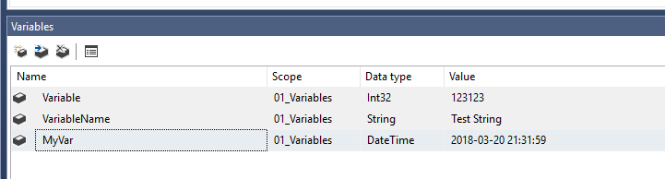
Variables
Variables store values that a SQL Server Integration Services package and its containers, tasks, and event handlers can use at run time. The scripts in the Script task and the Script component can also use variables. The precedence constraints that sequence tasks and containers into a workflow can use variables when their constraint definitions include expressions.
Integration Services supports two types of variables: user-defined variables and system variables. User-defined variables are defined by package developers, and system variables are defined by Integration Services. You can create as many user-defined variables as a package requires, but you cannot create additional system variables.

Slide 4
Execute SQL Task part. 2

Slide 5
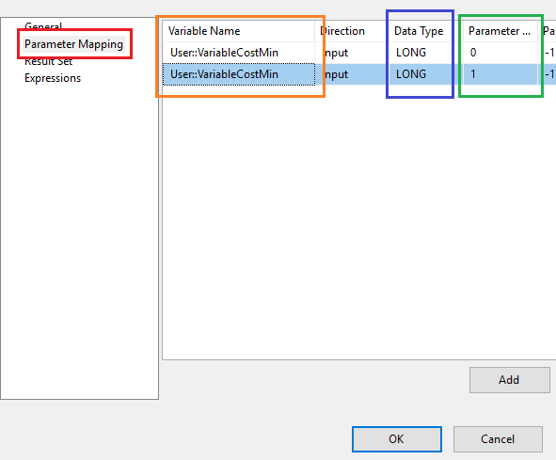
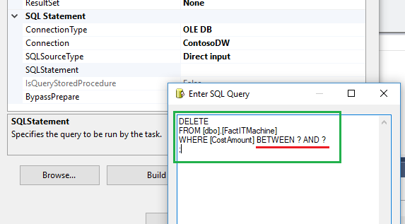
Parameter Mapping
„?” – place for parameter

Slide 6
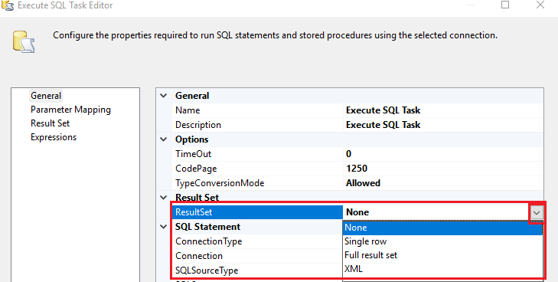
Result Set
The None result set is used when the query returns no results.
The Single row result set is used when the query returns only one row.
The Full result set result set is used when the query returns multiple rows. .
The XML result set is used when the query returns a result set in an XML format.
https://msdn.microsoft.com/pl-pl/library/cc280492(v=sql.110).aspx

Slide 7
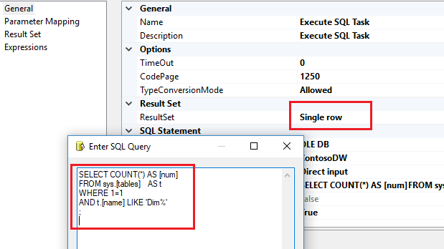
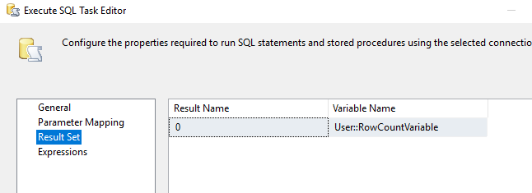
Result Set – single row

Slide 8
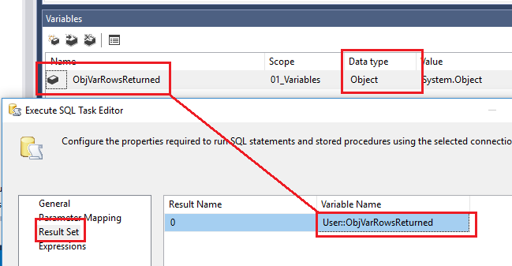
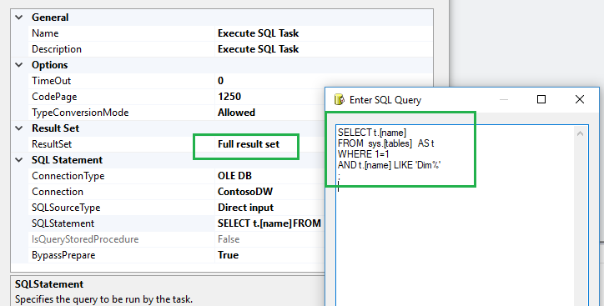
Result Set – full result set
A Full result set must map to a variable of the Object data type. The return result is a rowset object. You can use a Foreach Loop container to extract the table row values that are stored in the Object variable into package variables, and then use a Script Task to write the data stored in packages variables to a file.

Slide 9
Control Flow

Slide 10
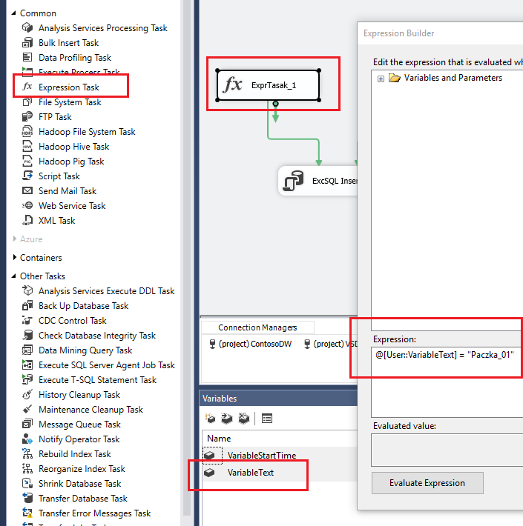
Expression Task
The Expression Task creates and evaluates expressions that set variable values at runtime, using the Expression Builder. When you edit the task, the Expression Builder is launched.

Slide 11
Data Flow

Slide 12
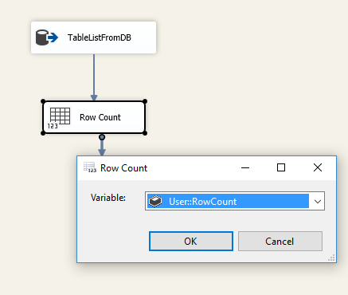
RowCount
The Row Count transformation counts rows as they pass through a data flow and stores the final count in a variable.
A SQL Server Integration Services package can use row counts to update the variables used in scripts, expressions, and property expressions.
The variable that the Row Count transformation uses must already exist, and it must be in the scope of the Data Flow task to which the data flow with the Row Count transformation belongs.

Slide 13
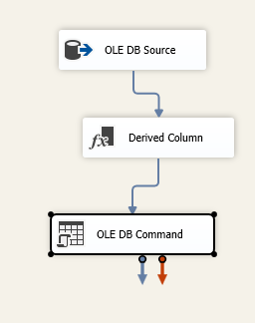
OLEDB Command
The OLE DB Command transformation runs an SQL statement for each row in a data flow. For example, you can run an SQL statement that inserts, updates, or deletes rows in a database table.
You can configure the OLE DB Command Transformation in the following ways:
Provide the SQL statement that the transformation runs for each row.
Specify the number of seconds before the SQL statement times out.
Specify the default code page.

Slide 14
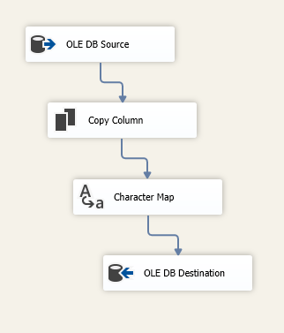
Character Map
The Character Map transformation applies string functions, such as conversion from lowercase to uppercase, to character data. This transformation operates only on column data with a string data type.
The Character Map transformation can convert column data in place or add a column to the transformation output and put the converted data in the new column. You can apply different sets of mapping operations to the same input column and put the results in different columns.
For example, you can convert the same column to uppercase and lowercase and put the results in two different columns.

Slide 15
Copy Column
The Copy Column transformation creates new columns by copying input columns and adding the new columns to the transformation output. Later in the data flow, different transformations can be applied to the column copies.
For example, you can use the Copy Column transformation to create a copy of a column and then convert the copied data to uppercase characters by using the Character Map transformation, or apply aggregations to the new column by using the Aggregate transformation.

Slide 16
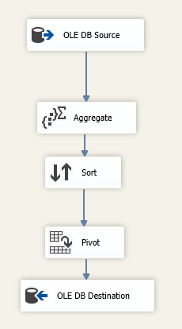
Pivot/Unpivot
The PIVOT transformation makes a normalized data set into a less normalized but more compact version by pivoting the input data on a column value.
To pivot data efficiently, which means creating as few records in the output dataset as possible, the input data must be sorted on the pivot column. If the data is not sorted, the Pivot transformation might generate multiple records for each value in the set key, which is the column that defines set membership.
The UNPIVOT transformation makes an unnormalized dataset into a more normalized version by expanding values from multiple columns in a single record into multiple records with the same values in a single column.

